Slide 1

INTERNSHIP REPORT&PROJECT REVIEW-2
INTERSHIP PERIOD : 29-05-2024 TO 30-07-2024
STUDENT NAME : K . CHINNI KRISHNA
ROLL NO : 21691A3708 IV CSE(CS)
REVIEW DATE : 30-11-2024
INTERNSHIP MENTOR : Mrs. A. KOMALA
I

Slide 2

File Data Secure Tool
Using AES & DES
Securing your data with advanced encryption.
by CHINNI KRISHNA
21691A3708

Slide 3

Introduction
1
AES Algorithm
2
User-Friendly Interface
Strong encryption for sensitive data.
Easy to use for everyone.
3
Notifications
4
Complete Features
Clear feedback and guidance.
Encryption, decryption, restart, and close.

Slide 4
Problem Statement
Data Security
User-Friendly Solutions
Key Management
Growing threats to sensitive data.
Lack of easy-to-use encryption tools.
Complex process for managing keys.

Slide 5

AES Algorithm Overview
Symmetric Algorithm
NIST Approved
Same key for encryption and decryption.
High security standard for sensitive data.
Block Size
Key Lengths
128 bits for robust data processing.
128, 192, and 256 bits for increased security.

Slide 6
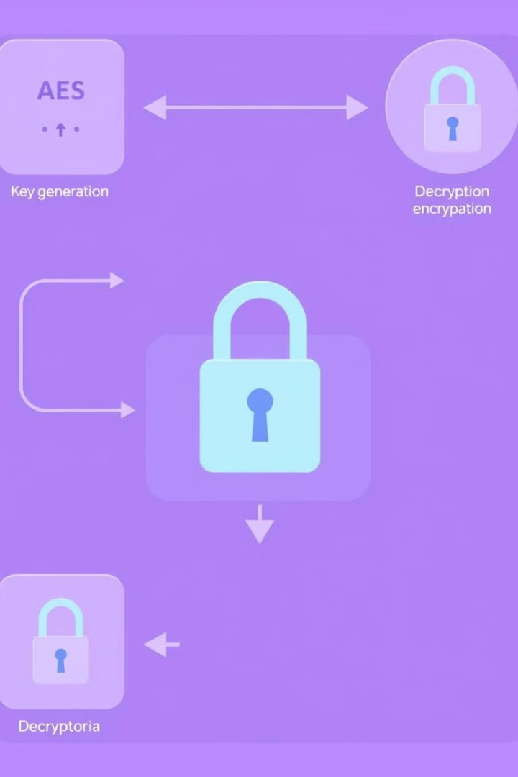



Project Workflow
User Input
File upload and key provided.
Encryption/Decryption
AES EAX mode for security and authentication.
Output
Encrypted or decrypted file saved.

Slide 7
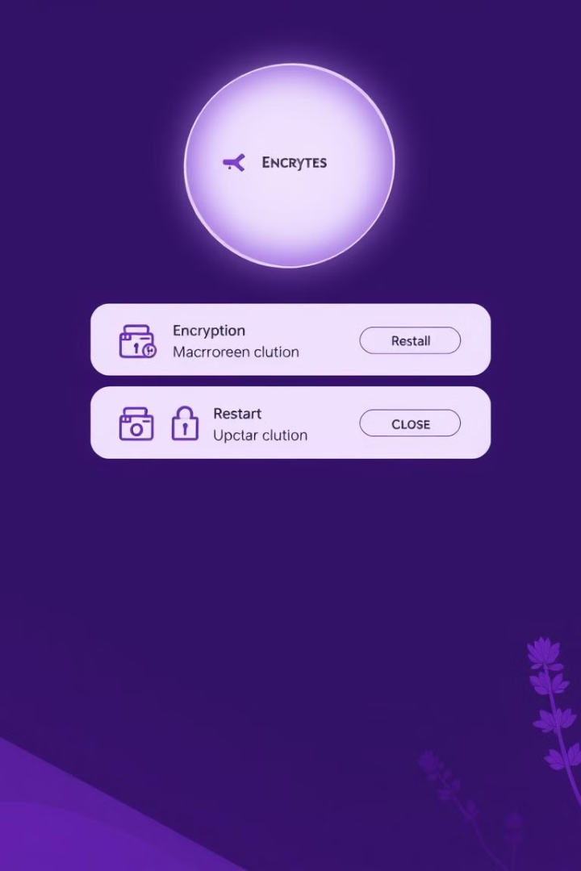
Key Functionalities
Encryption
Decryption
Notifications
Restart/Close
File upload and key input.
Upload encrypted file, enter key.
Success, error, and prompt messages.
Options to restart or exit the application.

Slide 8
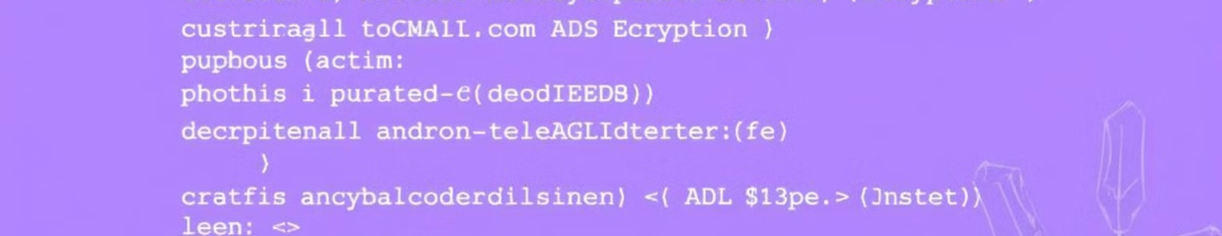
Code Highlights
1
Encryption
2
Decryption
3
GUI Snippet
Utilizes AES EAX mode for secure encryption.
Verifies data integrity during decryption.
Simple GUI implementation with tkinter.

Slide 9
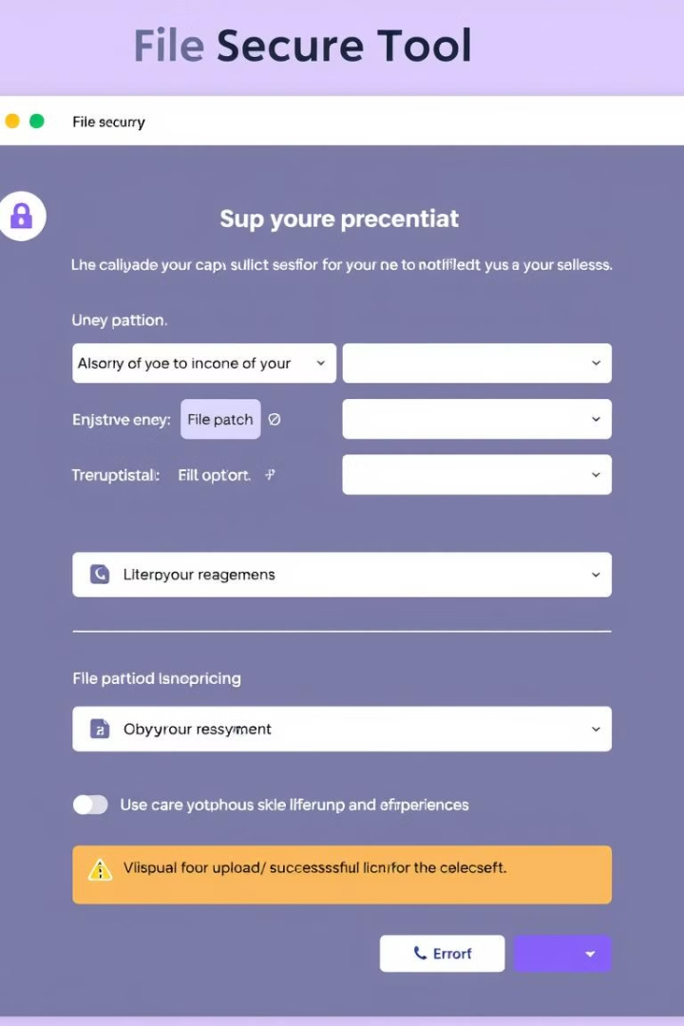




GUI Features
File Upload
Key Input
Select files for encryption or decryption.
Enter or generate a secure encryption key.
Encryption/Decryption
Notifications
Process files with the chosen key.
Provide feedback on the process and potential errors.

Slide 10
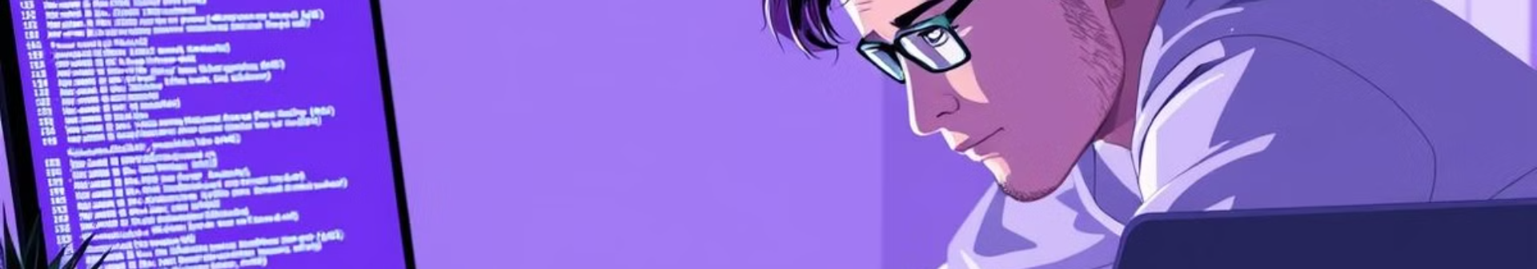
Challenges Faced
Key Management
1
Handling key length and security.
2
File Validation
Ensuring valid file types and handling errors.
User Interface Design
3
Creating an intuitive and user-friendly GUI.

Slide 11

Future Improvements
1
Key Generation and Storage
2
Additional Encryption Modes
Secure key generation and storage for users.
Support for different encryption modes (e.g., CBC, GCM).
3
Multiple File Support
4
GUI Enhancements
Ability to encrypt or decrypt multiple files at once.
Improved aesthetics and features for a better user experience.

Slide 12
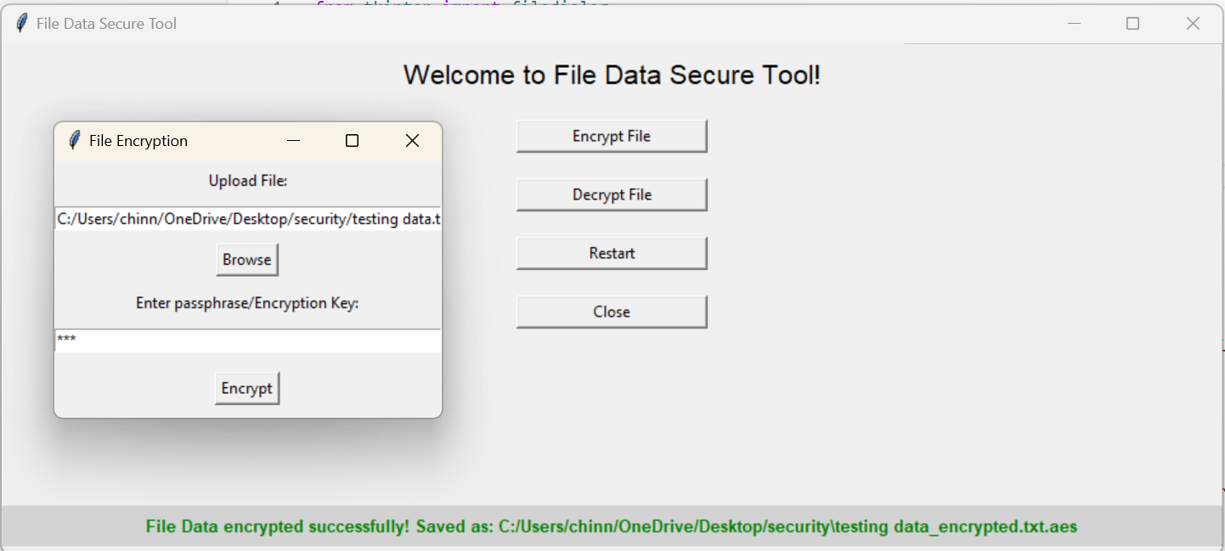
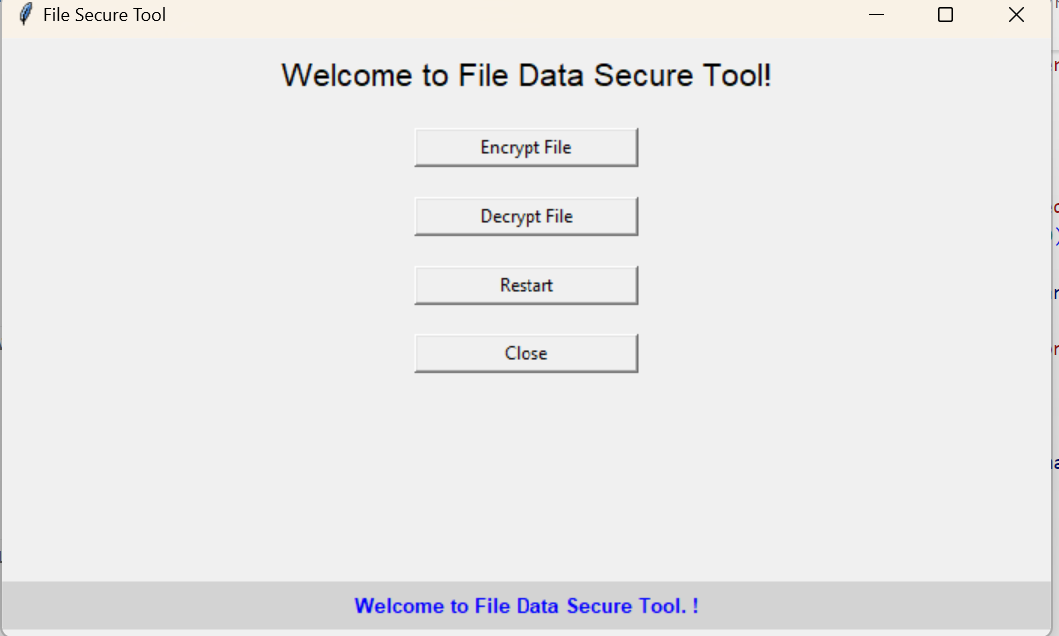
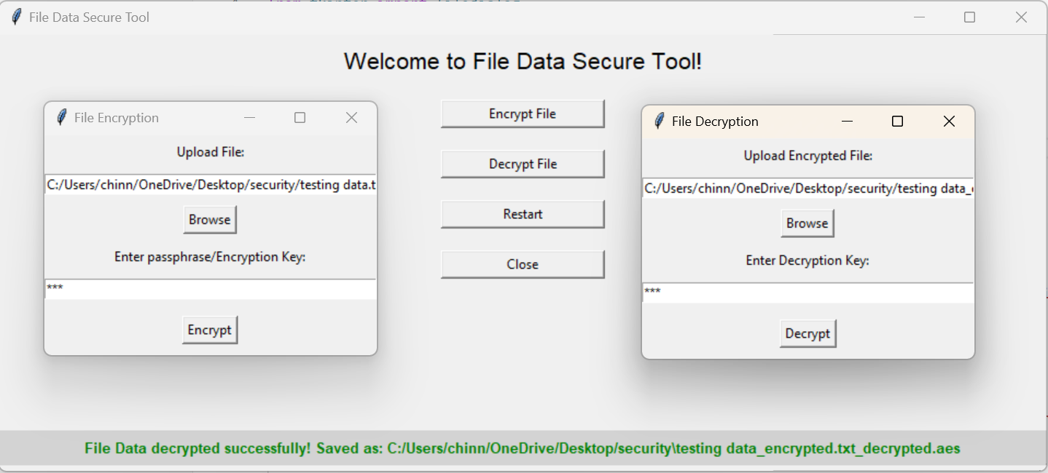
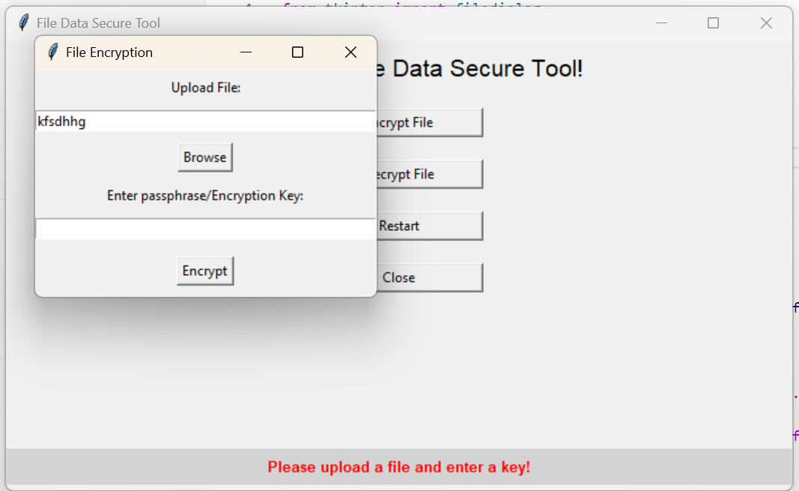
Demo output
Similarly, the file decryption window enables users to decrypt files by providing the necessary encryption key, ensuring the integrity of their data.

Slide 13

Conclusion: A Secure and Intuitive File Encryption Solution
The File Secure Tool offers a robust and user-friendly approach to protecting sensitive data. By leveraging the power of the AES encryption algorithm, this application ensures the confidentiality and integrity of your files, giving you peace of mind when handling critical information.

Slide 14
Thank You !

